Slide 2

Geht ned.
Doesn‘t work.
Zu wos brauch ma des? What for?
Wånns unbedingt sei muas.
If (really) necessary.
© Mikael Wiman, Flickr, Creative Commons

Slide 3
Geht ned.
Doesn‘t work.

Slide 4
Windows 8: No, because…
Less possibilities than in .NET
Sandbox
Missing Third-party controls
Windows 8 as a prerequisite
Fullscreen
Bad for keyboard and mouse
Store deployment

Slide 5
Less possibilities than in .NET/WPF?
WPF vs. UWP
Still differences, e.g. bei Bindings
But: Further improvements in UWP, which are not available in WPF
Compiled Bindings (x:Bind)
.NET Native
Responsive Design (RelativePanel, Setters im VisualStateManager)
Access to sensors, camera, etc.
Massive investments in the API
Sockets, hardware access, etc.
Entity Framework 7
Notes:
The .NET Native toolchain will compile your managed IL binaries into native binaries. Every managed (C# or VB) Universal Windows app will utilize this new technology. The applications are automatically compiled to native code before they reach consumer devices.

Slide 6
Sandbox
More and more functionality allowed
Communication between Apps (App Services)
Hardware
„Privacy-aware Apps“
Contacts
Home network
Music, images, videos
Biggest limitation: access to disk
Publisher Cache Folder

Slide 7
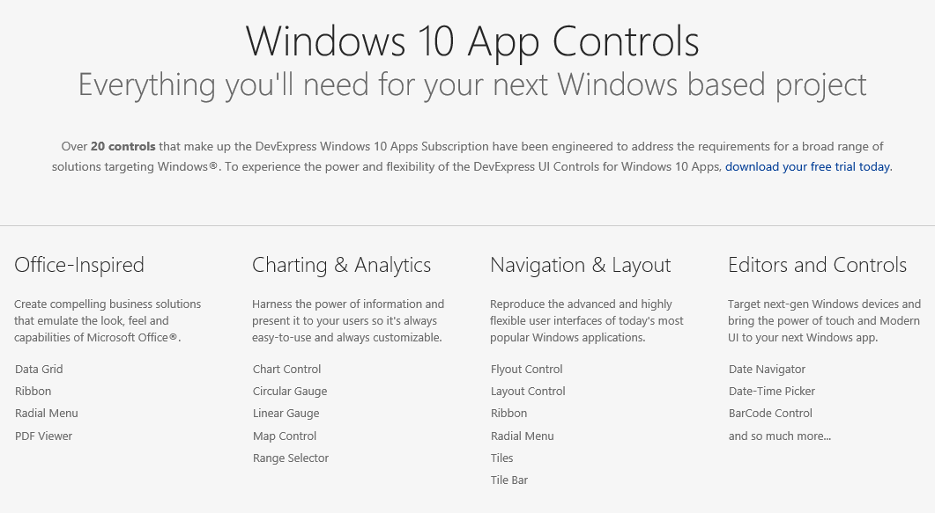
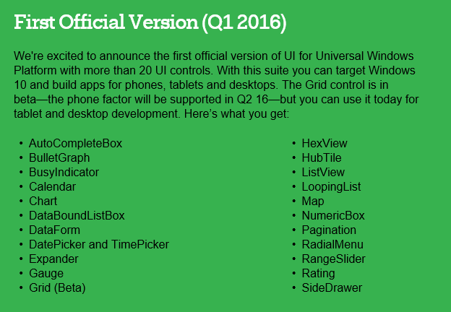
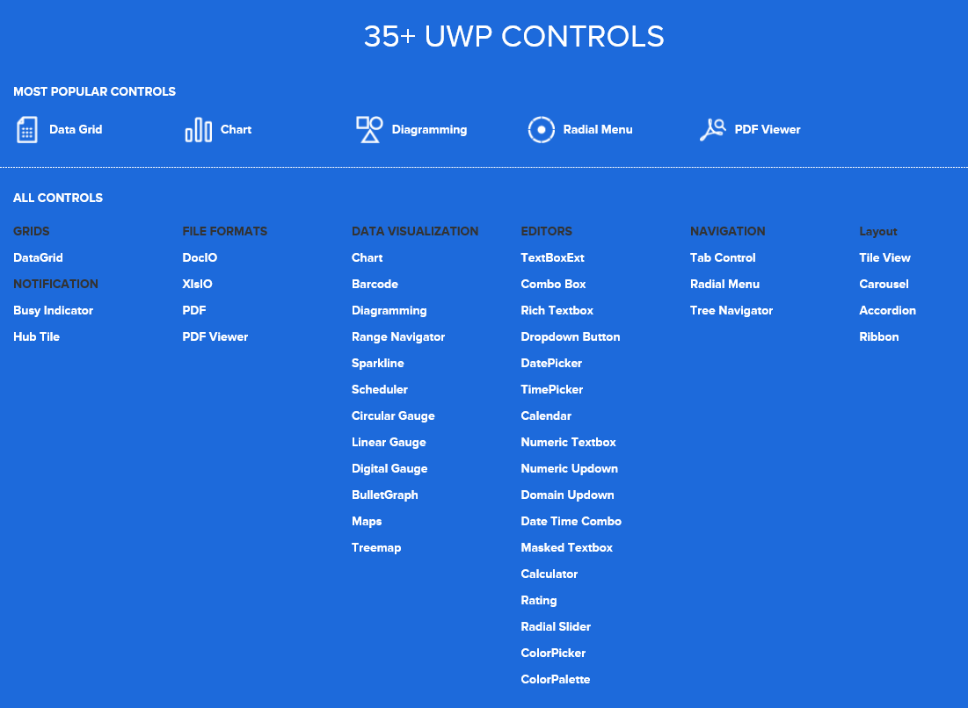
Missing third-party controls
DevExpress
Telerik
Syncfusion
etc.

Slide 8

200
More than 200 million devices are running Windows 10 in 192 countries across the world. (That’s nearly every country on the planet.) Our goal is to reach 1 billion Windows 10 devices by 2018.
Source: Microsoft

Slide 9
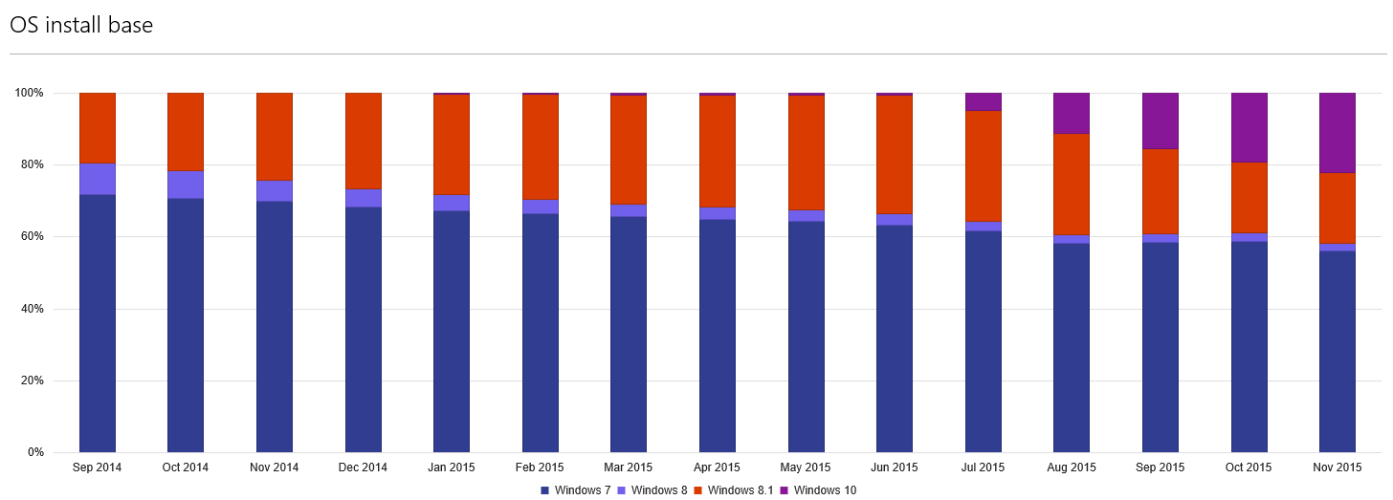
Windows as pre-requisite
https://dev.windows.com/en-us/windows-trends

Slide 10
Windows is now Windows again.

Slide 11
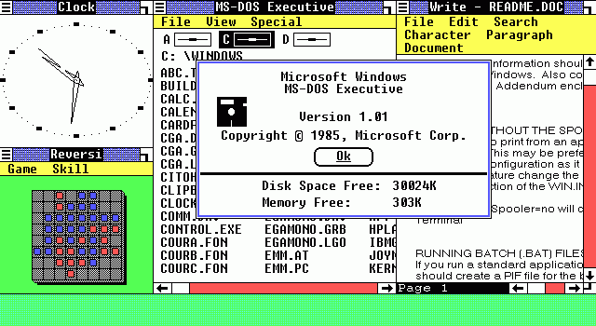

Slide 12
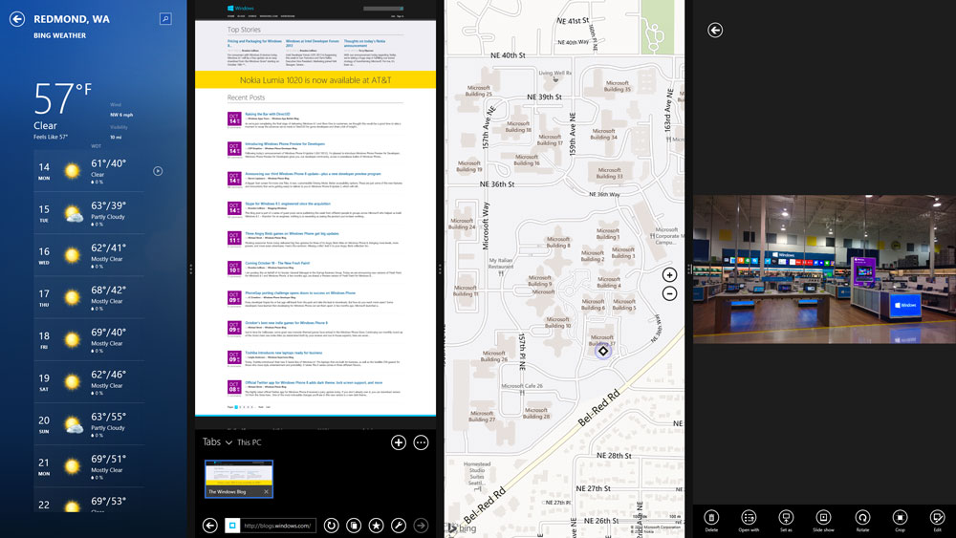

Slide 13
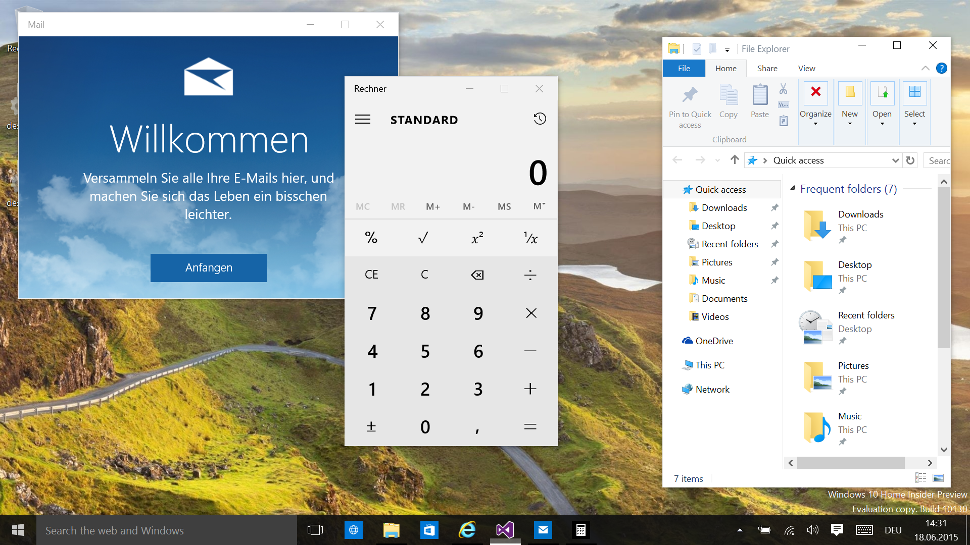

Slide 14


Slide 15
Bad for mouse and keyboard: Continuum mode
Windows
Fullscreen
Back-Button in title
Back-Button bottom left
„Windows 7“ start menu
„Windows 8“ start menu
Taskbar
No Taskbar

Slide 16
Deployment through Store
Visibility
Public
Public with link
Public with link and coupon code
Volume licenses (derzeit nur für kostenlose Apps)
Windows Store for Business
Offline aquisitions
Download of app packages including license

Slide 17
Windows 8: No, because…
Less possibilities than in .NET
Sandbox
Missing Third-party controls
Windows 8 as a prerequisite
Fullscreen
Bad for keyboard and mouse
Store deployment

Slide 18
Zu wos brauch ma des?
What for?

Slide 19
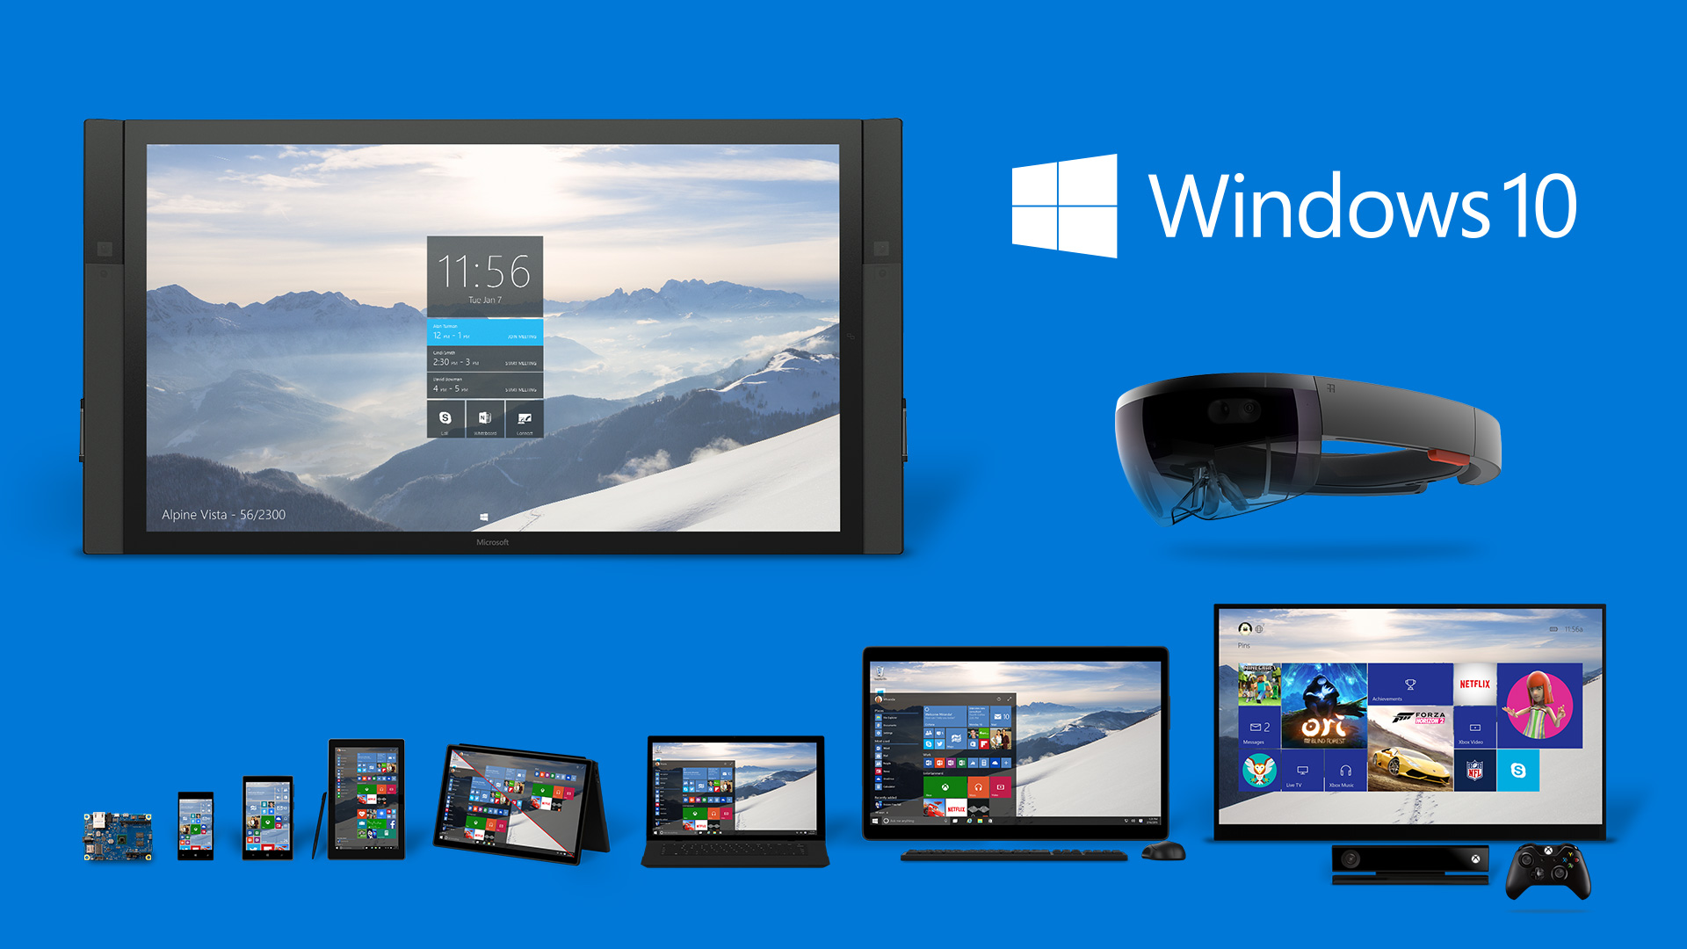

Slide 20
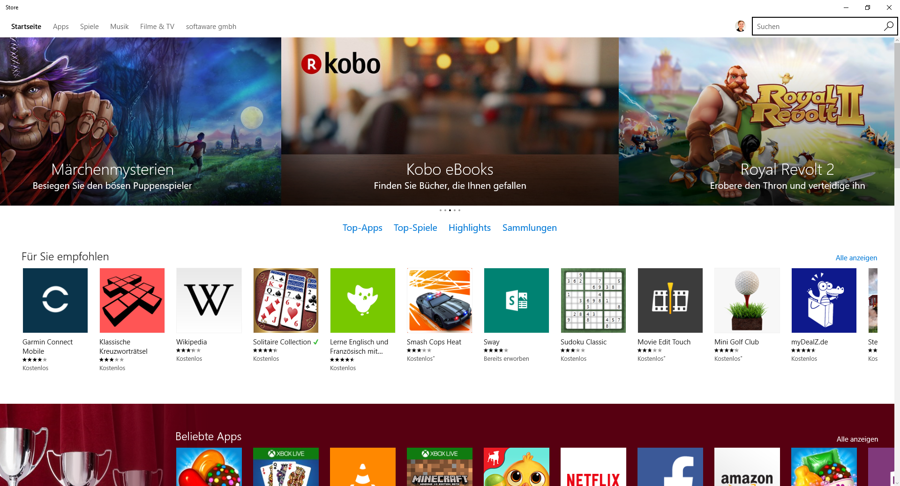
Marktplatz

Slide 21
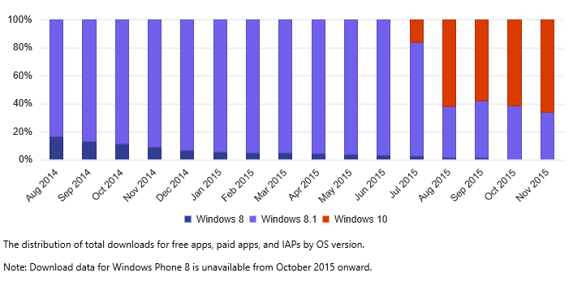
Downloads
https://dev.windows.com/en-us/windows-trends

Slide 22
Billing
Features
Test versions
In-App purchases
Coupons
Special offers
Payment
Credit card, Phone providers
Expiration of card
Invoice generation, VAT, etc.

Slide 23
Wånns unbedingt sei muas.
If (really) necessary.

Slide 24

Architecture
Service-oriented architecture
REST-APIs
OAuth
Azure

Slide 25

Short release cycles
Agile development
Continuous Integration
Frequent Updates
Focus on relevant features

Slide 26

Changes in the business model
Disruptive innovation
More customers, (drastically) cheaper prices?
Different marketing strategies
Billing
Test versions
Subscriptions
In-App-Purchases
Special offers

Slide 27


More competition, more feedback
Store purchase vs. Face-to-face
Feedback of users
Praise
Feature wishes
Lack of understanding
Errors
Device problems

Slide 28
It works.
Advantages.
Your business changes.
© Mikael Wiman, Flickr, Creative Commons

